Slide 1
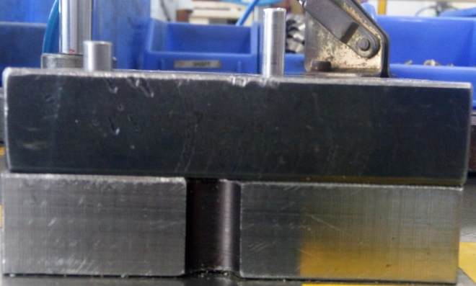
P15
TPM CIRCLE NO :- 01
ACTIVITY
KK
QM
PM
JH
SHE
OT
DM
E&T
KAIZEN IDEA SHEET
TPM CIRCLE NAME:
LOSS NO. / STEP
DEPT :- ASSEMBLY
RESULT AREA
P
Q
A
C
D
S
M
CELL:- oil pump
CELL NAME:- A354
MACHINE / STAGE :- Assembly
OPERATION :- Plate fitment
KAIZEN THEME : To avoid the mixing of A314 shaft into the A354 during assembly of pump.
IDEA :- Separate modified fixture to be provided for A314 oil pump assembly.
Problem present status :- A314 shaft not detect in process during assembly of A354.
COUNTERMEASURE:-
Separate assembly fixture to be implement for A314 assembly so there is no need to adjust the length sensor during set up change
Fixture changing point is to be add in set up approval.
BENCHMARK
TARGET
KAIZEN START
30.09.2016
TDC
25.10.2016
TEAM MEMBERS : Amit Dhage, Nitin Sutar,
KAIZEN FINISH
BENEFITS :-
1) To eliminate the customer complaint of wrong shaft mix-up
Before
After
KAIZEN SUSTENANCE
WHY - WHY ANALYSIS :-
Why1 :- A314 shaft not detect in process during assembly of A354
Why2 :- Shaft total length Poke-Yoke disturb
Why3 :- Manual adjustment of shaft length sensor Why4:- Same assembly fixture for both products with common one sensor.
RESULT :-
WHAT TO DO:- Check point is to be added in set up approval .
HOW TO DO:- At the start of during set up change.
FREQUENCY :- During set up change.
ROOT CAUSE : Same assembly fixture for both products with common one sensor.
REGISTRATION NO. & DATE : 30.09.2016
SCOPE & PLAN FOR HORIZONTAL DEPLOYMENT
REGISTERED BY :- Amit Dhage
SR.
NO.
CELL
TARGET
RESPONSIBILITY
STATUS
MANAGER’S SIGN :- Sandeep Patil
1
NA
NA
NA
NA

